Slide 1

Final Presentation
Stay-N-Sleep Loyalty Program
Anubha Gargav (PM)
Date : 09/21/2023

Slide 2

Final Presentation:
Loyalty Program (LP)
Final Presentation
Current State:
The Stay-N-Sleep, American vacation rental online marketplace with it’s worldwide presence offers unique, authentic places to stay and things to do.
Situation:
Inquiries in last 6 months by valued customers to get rewarded for their trip bookings.
Messaging:
StayNSleep, the world's leading hospitality platform, is thrilled to announce the launch of our brand-new loyalty program, designed to provide even more value and rewards to our valued guests.

Slide 3
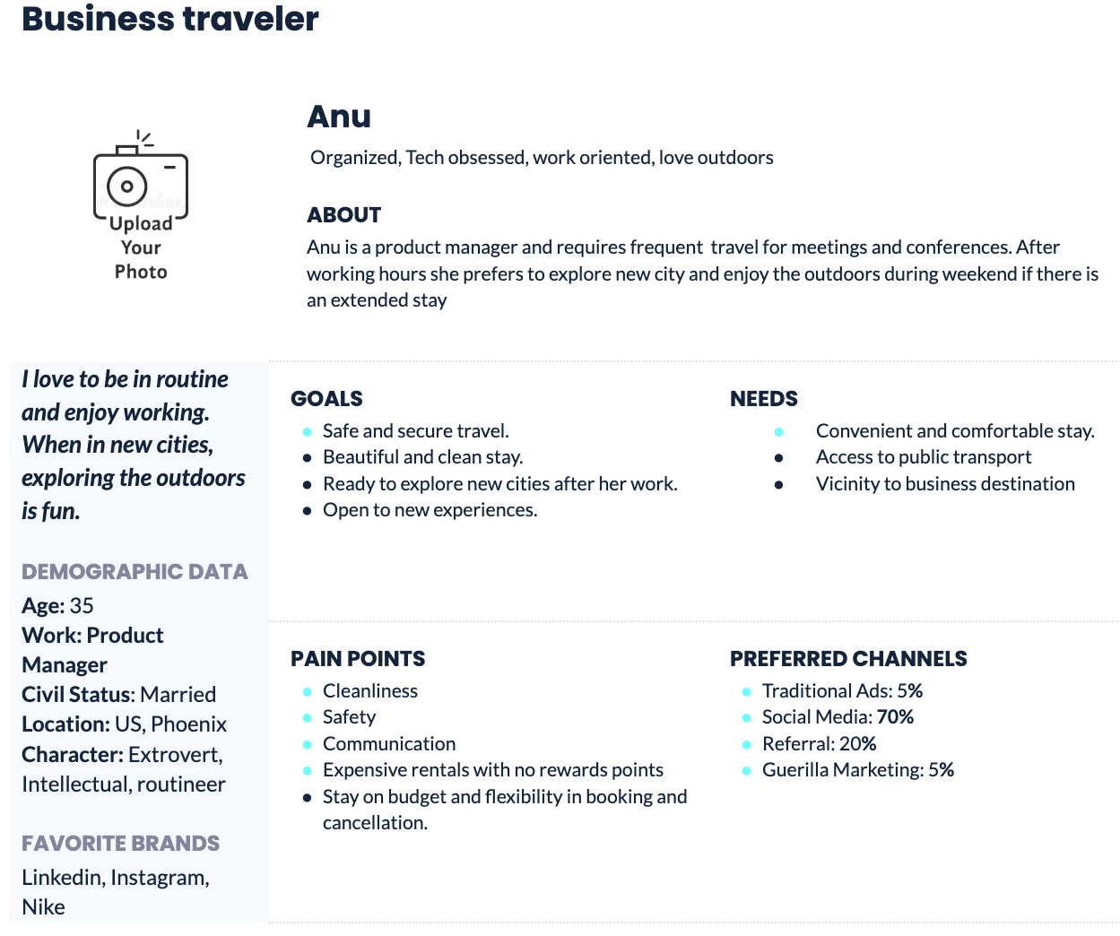
Personas: With an assumption, we have 10% of total 20M+ guests that is approx 2M of business traveler.

Slide 4
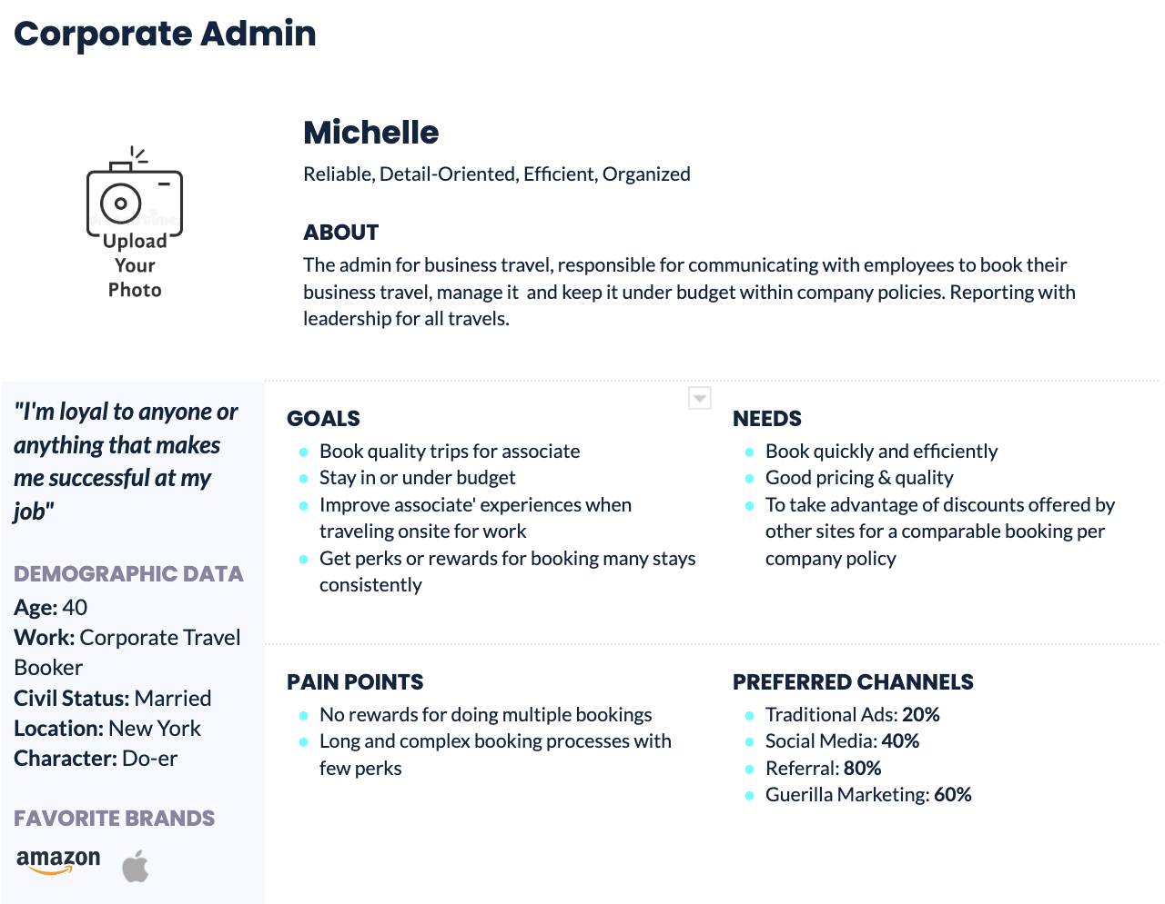
Personas: Booker
Templates: Personas here

Slide 5
Final Presentation:
Loyalty Program
Final Presentation
Hypothesis & Validation:
I believe that Business travelers can rewarded with 5x points on each dollar spent for their booking.
I will know this is true when I see a 50% increase in usage of product and 31% more spent by existing customers than new ones.
Benefits comes with a free Admin dashboard for Corporate Admins to manage and reporting company trips.
Templates: Hypothesis Statement here

Slide 6
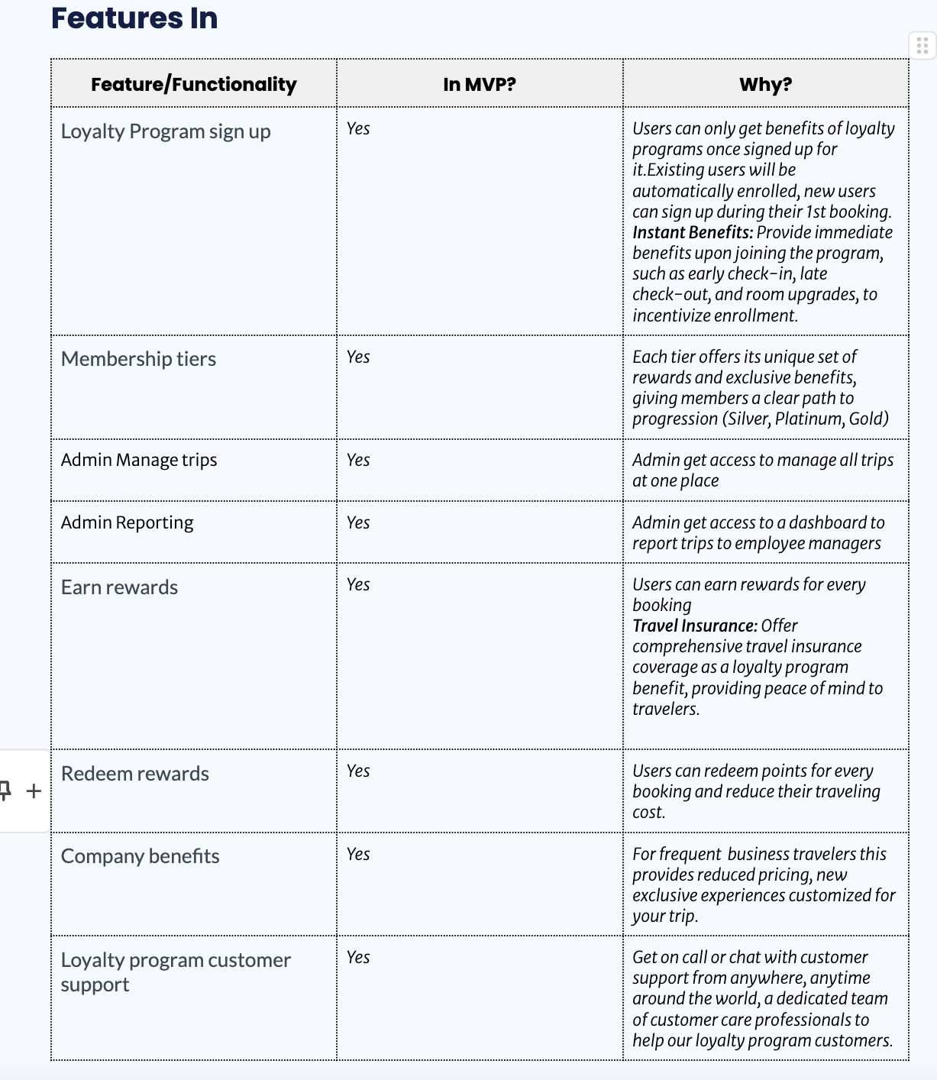
Final Presentation:
Loyalty Program
PRD & MVP Features:
Offshoot of a mobile app for business traveler.
New features added to existing web app for Admin dashboard.
Benefits over competitor:
Instant Benefits: Early check-in, late check-out, and room upgrades, to incentivize enrollment.
Travel Insurance: Offer comprehensive travel insurance coverage as a loyalty program benefit, providing peace of mind to travelers.
Flexible Redemption: Redeem for car rentals and flights, existing partners of SNS
Templates: PRD here , KANO model here & MVP here

Slide 7
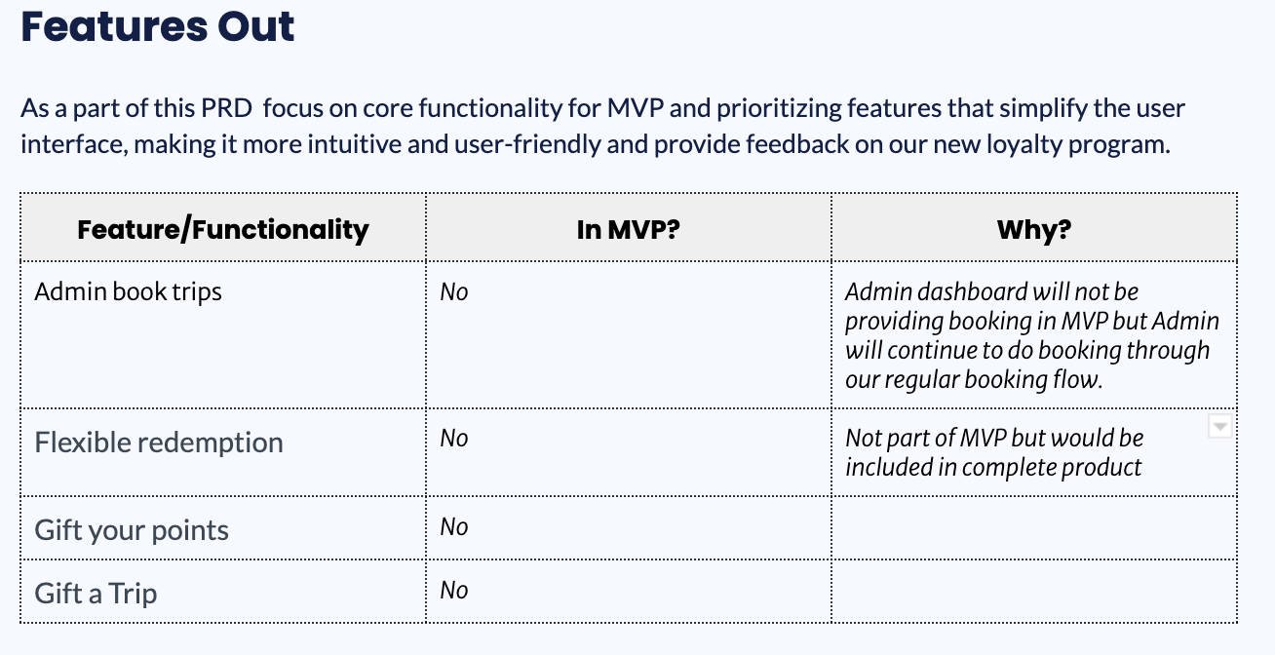
Future Iterations: Out for MVP
Templates: PRD here , KANO model here & MVP here

Slide 8
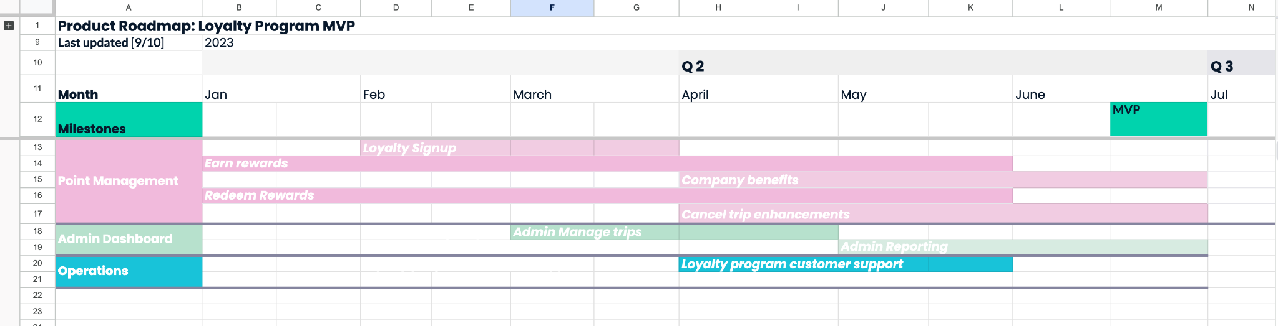
Final Presentation:
Loyalty Program
Final Presentation
Roadmap: Created a high-level roadmap detailing about our product development timeline.
Template: Roadmap here

Slide 9
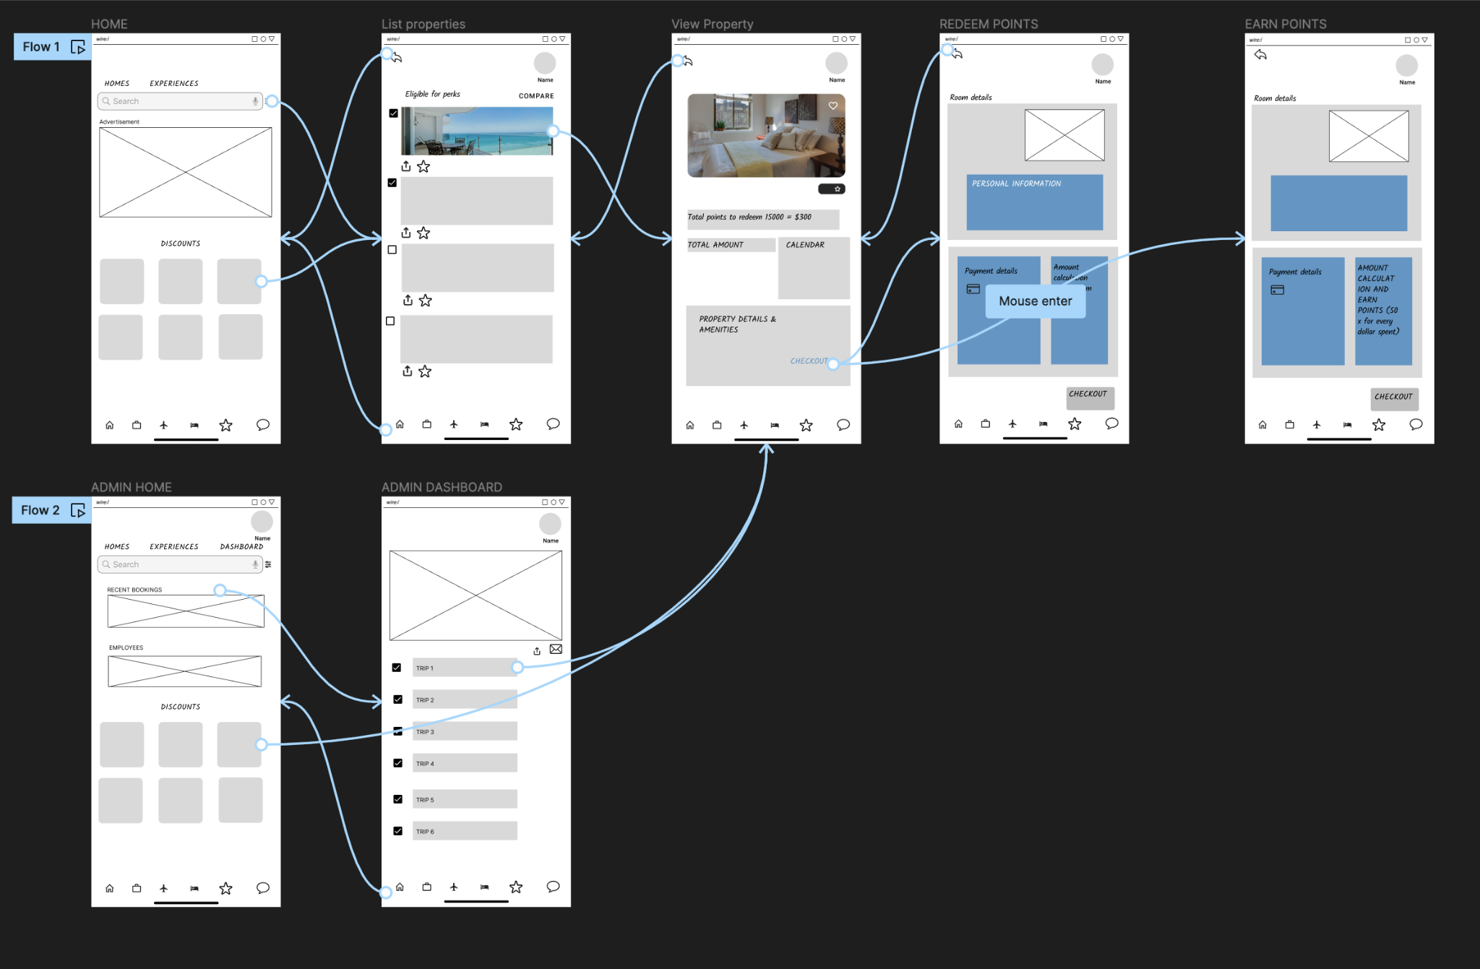
Final Presentation:
Loyalty Program
https://www.figma.com/file/Zqri9WSmPYSM5jYPdFeBIv/Untitled?type=design&node-id=0%3A1&mode=design&t=zDY0VCoqwVUnjola-1

Slide 10
Final Presentation:
Loyalty Program
Final Presentation
Engineering Sprints: Break down user stories into sprints, providing a detailed overview of the product development process from an engineering perspective.
Template: Sprint Template here.

Slide 11
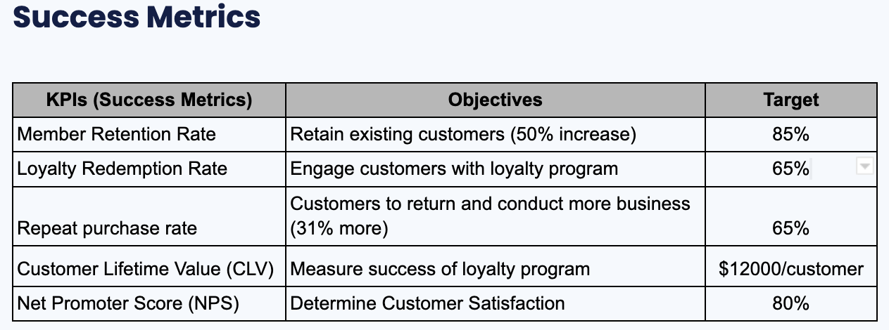
Final Presentation:
Loyalty Program
Final Presentation
LP aligns with company’s mission to build a community of lifelong travelers by measuring CLV metric And their vision is to connect people, enrich communities, and open minds to new experiences and cultures can be achieved with increase in Retention Rate and Customer satisfaction.
Template: For successful metrics use the PRD Template here.

Slide 12
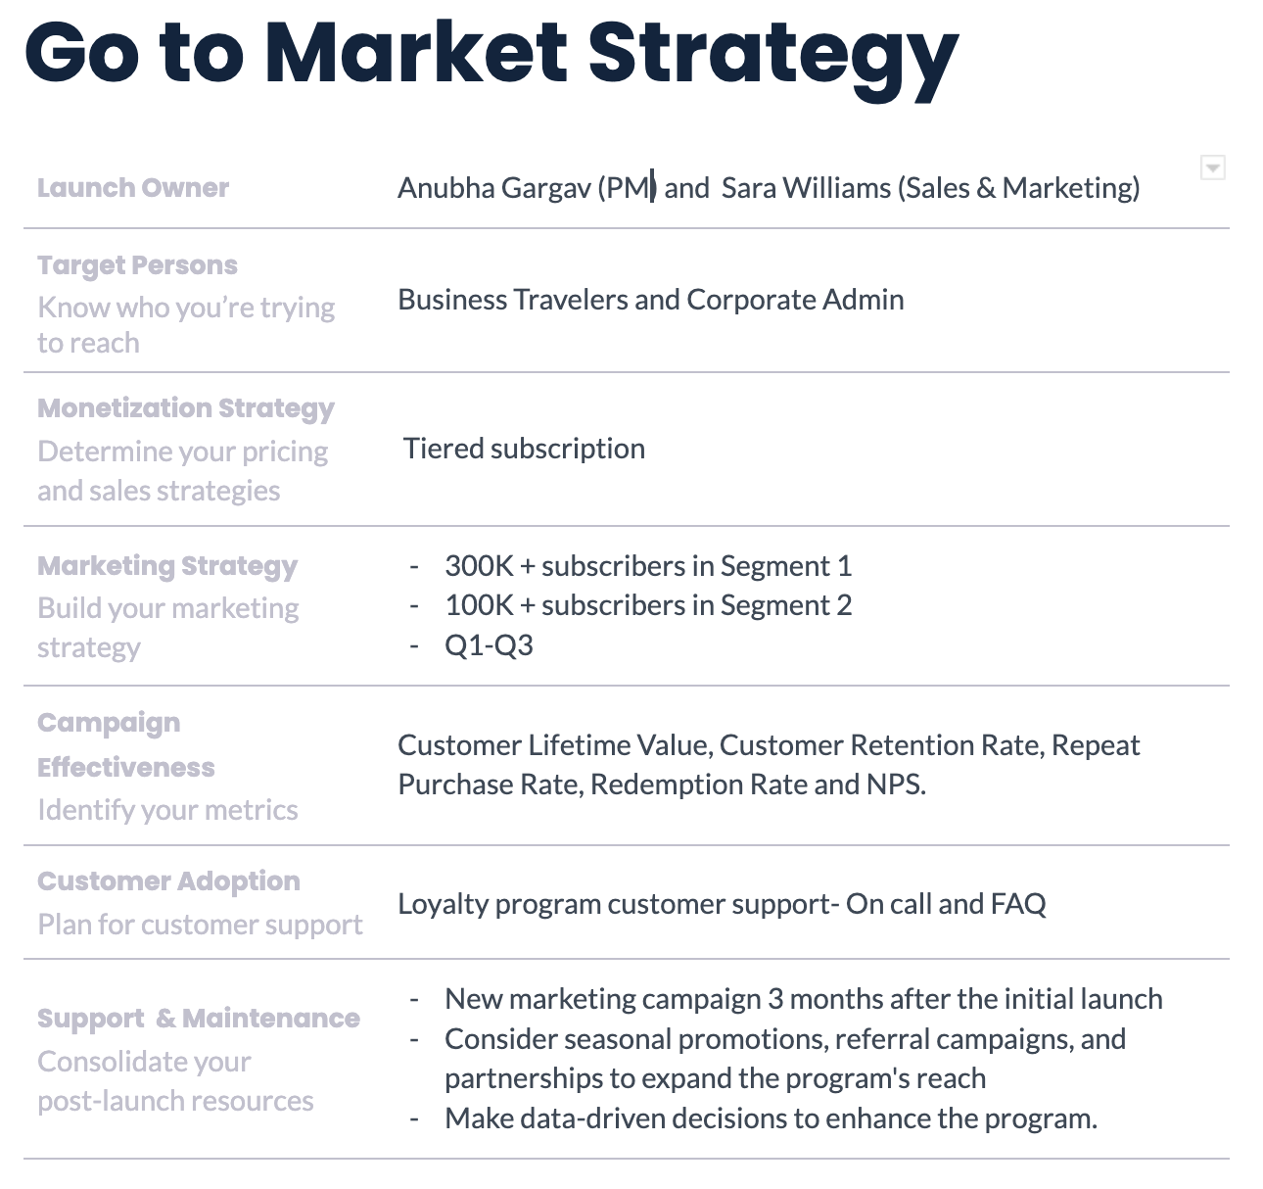
Template: Go to Market Strategy Template here

Slide 13
Final Presentation:
Loyalty Program
Final Presentation
Future State:
Stay-N-Sleep will launching a groundbreaking Loyalty Program MVP aimed at enhancing customer engagement and satisfaction . This program introduces membership tiers, points-based rewards, exclusive discounts, and personalized recommendations. It empowers both hosts and guests, fostering stronger connections and enriching travel experiences. Stay-N-Sleep's commitment to deepening relationships within its global community sets this loyalty program apart in the competitive travel landscape.

